Slide 1
DFEL
Deutsche Frauen Eishockey Liga

Slide 2
Facts
Female Ice Hockey in Germany
3.100 female hockey players / 3 – 60 years old
No Girls Teams
5* program : Development-Program
U13 / U15 → Regional Scouting
Support-system → U16 players
Growing success National Team
→ magenta TV
Visibility on Social Media

Slide 3
DFEL
Deutsche Frauen Eishockey Liga
TEAMS
- EC Bergkamen
- ECDC Memmingen Indians
- Eisbären Berlin Juniors
- ERC Ingolstadt
- Mad Dogs Mannheim
- KMH Budapest
FINAL STANDINGS
1. ECDC Memmingen
2. KMH Budapest
3. Eisbären Berlin Juniors
4. Mad Dogs Mannheim
5. ERC Ingolstadt
6. EC Bergkamen

Slide 4
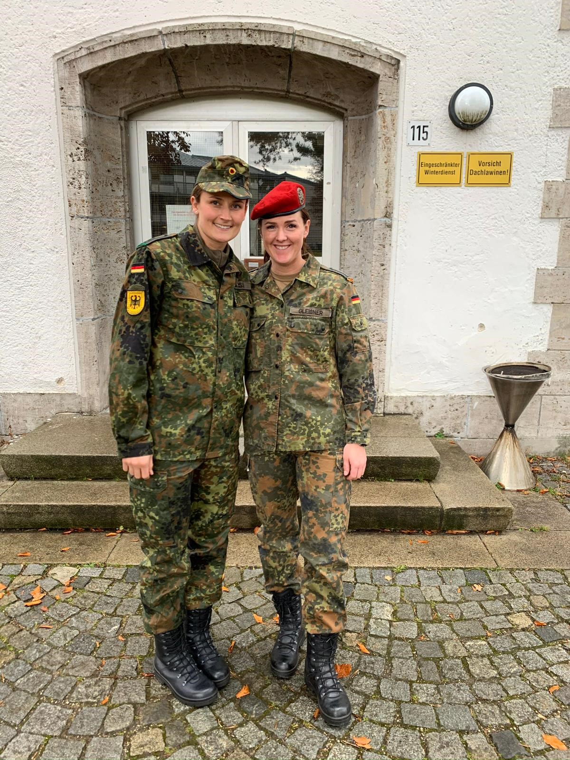
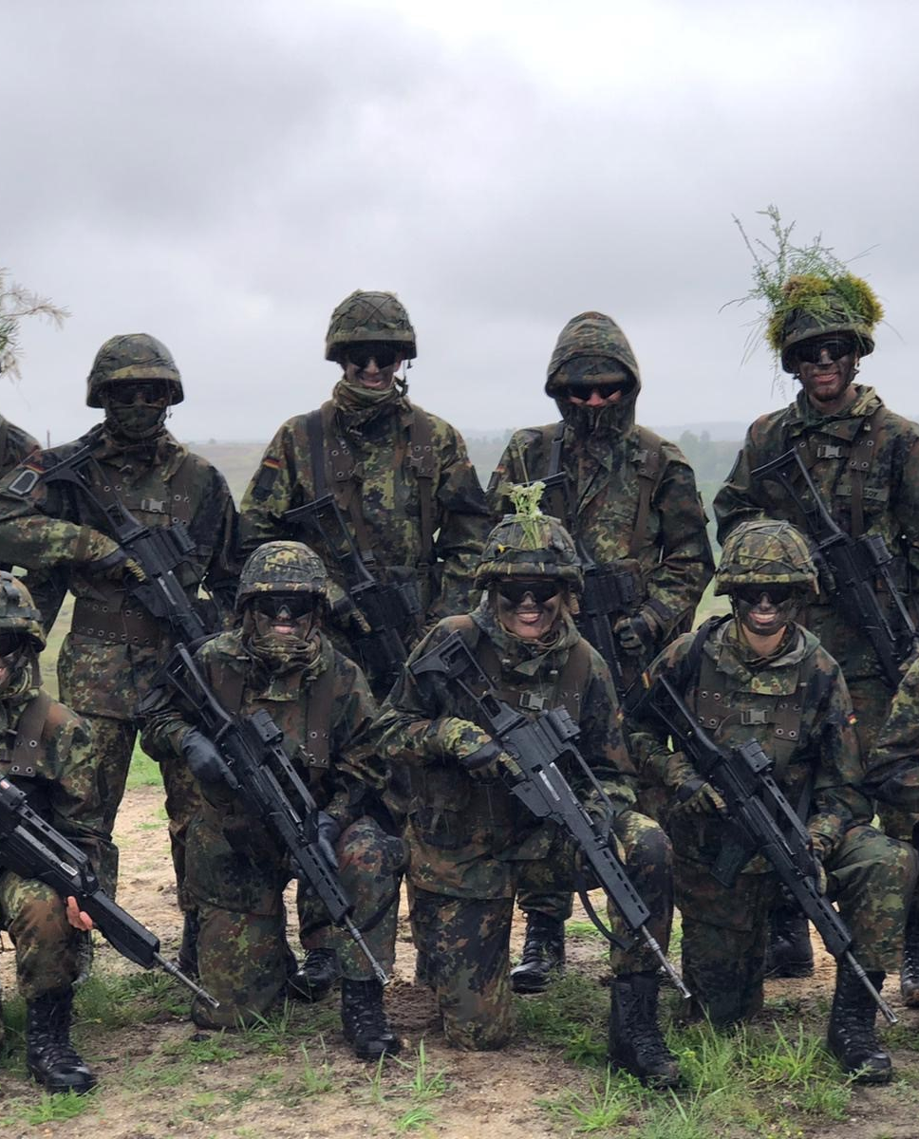
Bundeswehr - SPortfördergruppe
12 Bundeswehr Plätze

Slide 5
Structural development
Deutsche Frauen Eishockey Liga
Ligen Sponsor → blossom-ic
Best Player Helm
League-agreement: Practice Routine / Game Times / Video System / Statistic System
Instagram Account

Slide 6
Highlight events
Regular season
playoffs
Eisbären Berlin Juniors play at UBER ARENA
Set record: 2.800 spectators / 2023/24
Final Series Memmingen vs Budapest : 2.000 spectators

Slide 7
Ronja jenike
HEAD OF WOMENS HOCKEY GERMANY

